Slide 1
PROJECT PRESENTATION ON
TITLE : Playing Card Game
SEM : II
GUIDE : Amar Shinde
STUDENTS NAMES: Aishwarya Shinde
Seat No- 20995

Slide 2
Outline
Introduction
Literature Review
Problem Statement
Proposed Solution
Designing of System
Conclusion

Slide 3
INTRODUCTION
Playing online games can help to relax , lower stress levels , improve concentration as well as enhance creativity.
Key components of games are goals, rules, challenge, and interaction. Games generally involve mental or physical stimulation. Many games help develop practical skills like Patience , Decision making.
Our project is basically a two player multiplayer card game development using a simple python programming structures.
4) On our playing card game platform users can play card games with their friends ,cousin for fun.

Slide 4
LITERATURE SURVEY
Computer games and video games have become very popular in children and adolescents’ life and play a prominent role in the culture of young people
2)Games can now be played everywhere in technology with laptops, smart phones, game consoles and other digital devices.
3) Besides of an abundant appearance of games in young students life, game development technology has matured and became more advanced than before
4)Based on various existing game development software, the whole duty of game development process can be divided into several domains and roles such as game programmers, 3D model creators, game designers, musicians, animators, and play writers.
5)This makes it possible for students to modify existing games or develop their own new games with or without programming. They can design and implement their own game concepts with these game creation tools, learn the developing skills and relevant knowledge, and accumulate related practical experience.

Slide 5
PROBLEM STATEMENT
This concept is designed to teach you the foundations in order to make simple programs in Python using the most common structures. No previous exposure to programming is needed.
Design a Game which can be played in-house between two players while players can sit and get engaged physically and mentally.

Slide 6
Proposed Solution/System
Python is the most popular programming language or nothing wrong to say that it is the next- generation programming language. In every emerging field in computer science, Python makes its presence actively.
Python has vast libraries for various fields such as Machine Learning (Numpy, Pandas, Matplotlib), Artificial intelligence (Pytorch, TensorFlow), and Game development (Pygame,Pyglet).
Pygame
Pygame is a cross-platform set of Python modules which is used to create video games.
It consists of computer graphics and sound libraries designed to be used with the Python programming language.
Pygame was officially written by Pete Shinners to replace PySDL.
Pygame is suitable to create client-side applications that can be potentially wrapped in a standalone executable

Slide 7
How to play game
A standard 52-card deck comprises 13 ranks in each of the four suits: clubs (♣), diamonds (♦), hearts (♥) and spades (♠).
Two players can play card game against each other.
From the pack of 52 cards randomly 4 cards are distributed to both players.
Player have to select required card from the pack of cards provided by the system randomly.
Opportunity to replace a card from pack of card is given in one by one.
For win the game, players have to make a collection of 4 cards having the same rank.
The player who collect 4 card of same rank at first ,will win a game.
The Congratulaton SMS is sent to the player who win the game

Slide 8
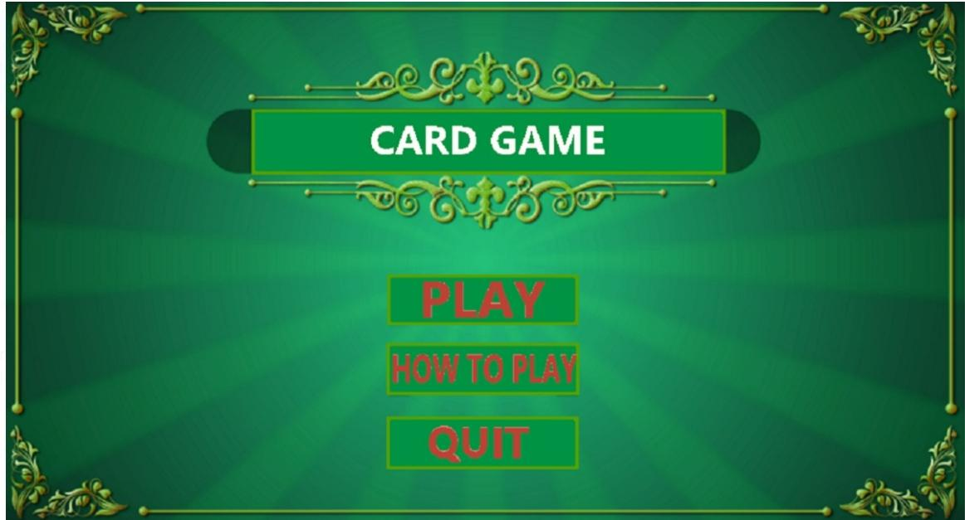

Slide 9
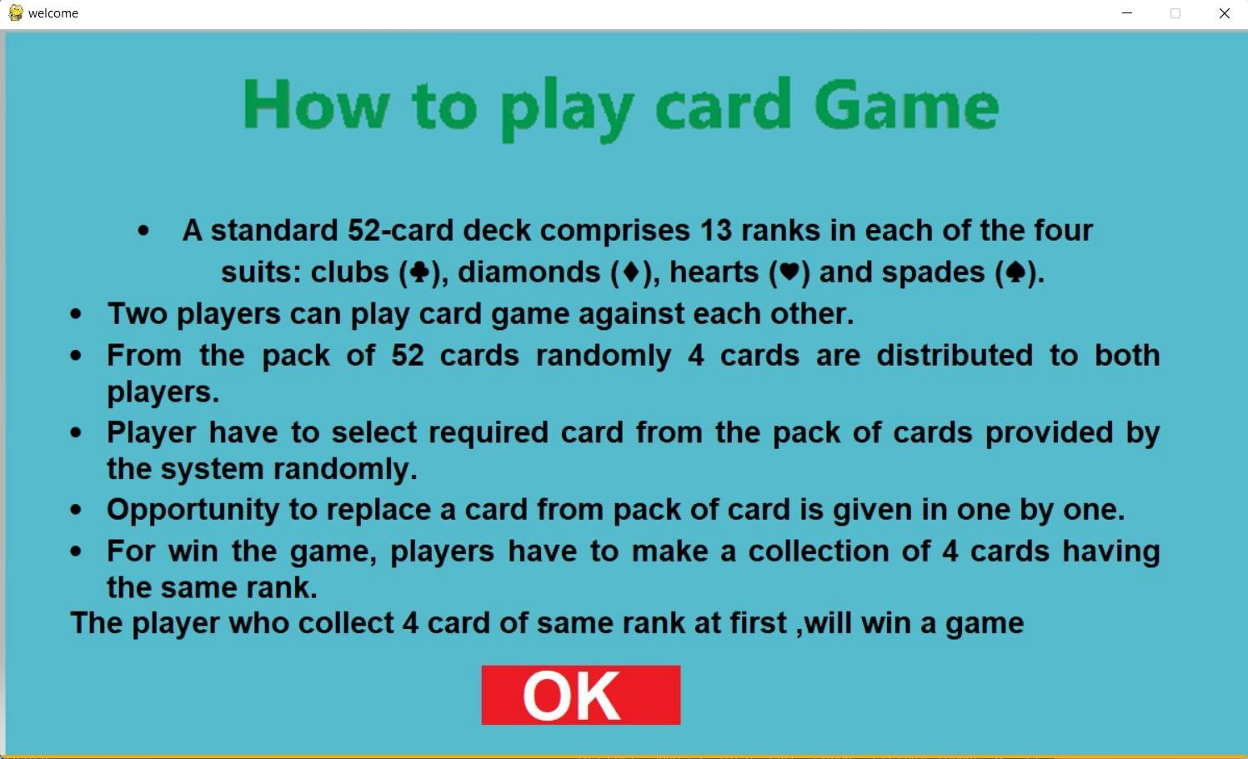

Slide 10
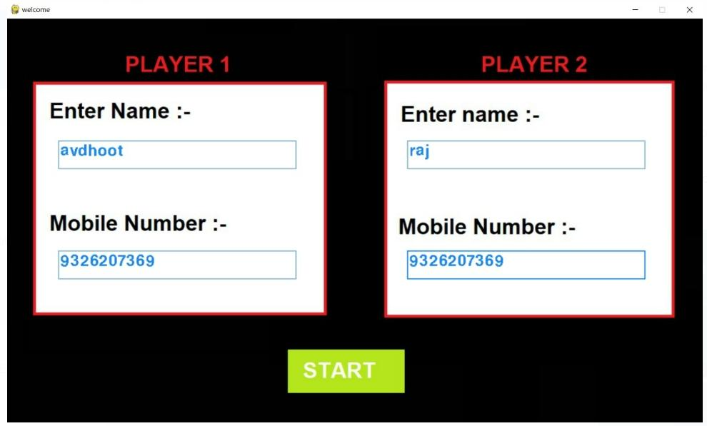

Slide 11
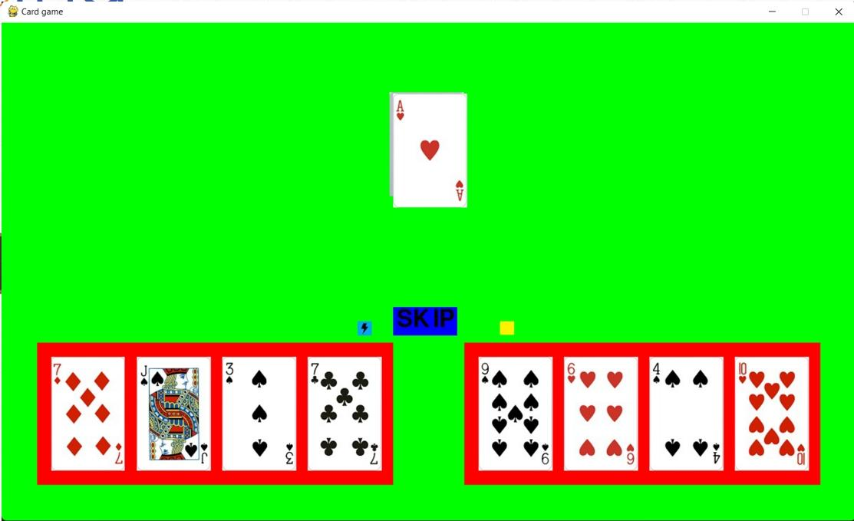

Slide 12
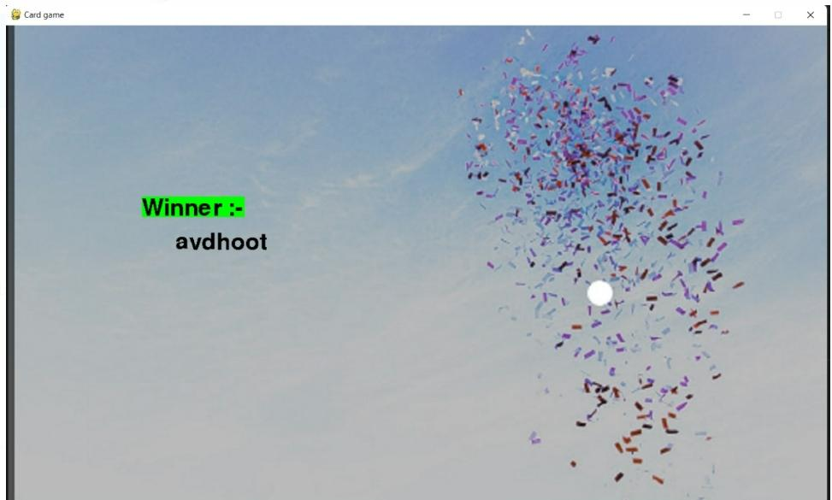

Slide 13
CONCLUSION
We tried to implement this game in a straightforward, testable, and modular form.
User can play card game virtually using our platform for fun Or relaxation.

Slide 14
References
1) https://gist.github.com
2)https://github.com/gdwangh/coursera-introPython/blob/master/week5/Mini-project%205%20-%20Memory.py
3) https://slideplayer.com/slide/222263/

